Slide 1
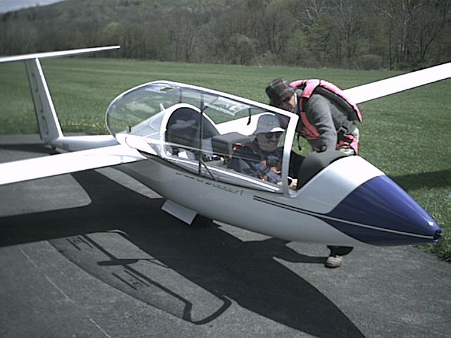
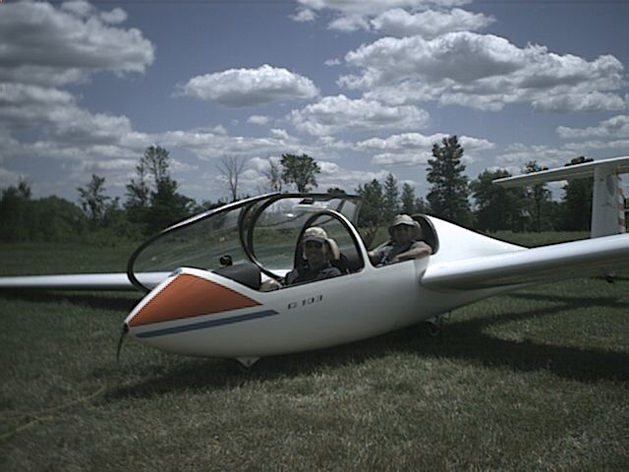
SAC INSTRUCTOR STANDARDS
Notes:
The information in this presentation is based on the current SAC Instructor Course

Slide 2
What are standards?
A consensus on
How something is to be done (how a lesson is to be taught)
The scope of skill and knowledge
The level of performance (knowledge or skill) that a student or instructor demonstrates
Who sets standards:
TC? clubs? provincial councils? FTSC? OSTIV?
Feedback - how achieved?

Slide 3
Where does this apply?
Curriculum – what is being taught and when
Pedagogy – how the information is passed
Testing
What performance is expected from student
How the instructor measures the performance
How performance is recorded
How that performance is shared
Safety
Notes:
Ask for examples

Slide 4
Why Standards?
Reduces the single most frustrating issue for students
Lessens the impact of high instructor turn over – volunteer status
Reduces unintended consequences – safety repercussions, hazard avoidance/risk mitigation
Shortens learning curves for students
Improves credibility as a teaching organization
Reduces instructor anxiety

Slide 5
Some problem areas
Preparatory Ground Instruction (quality and quantity)
Stall - lower nose recovery
Spin - inadequate training/stall symptoms
Gear operation – supervision
Rectangular patterns/offset
Teaching the circuit – too early/too much info
Rope break sequence – primacy
Teach landing then approach, then circuit
Lack of quiet periods after demos (demo, demo with explanation, practice)
Too much info during a lesson in general
Instructor talking when student flying
Instructor not ready on controls at critical times (“good pilot” risk)
Instructor moving controls but not telling student
Pre- landing checks before high key
Checklists differences and walk around omitted
Training accidents with/without instructors

Slide 6
Curriculum
Stages & content rationale
Sequencing rationale
Primary controls & gentle turns
Stalls
The landing
The circuit
Rope Breaks
Spins
Human Factors integration(HF teaching opportunities)
Safety integration – proactive safety culture, formalized safety training

Slide 7
Instructor Course Objectives
Safety throughout the spectrum of flight training
Instructor/student Teaching Theory
Instructor Ethics and Attitudes
Understanding of the Flight Exercises and a capability to perform demos that student can replicate
Analysis of student performance and ability to develop their skill/knowledge
Communication that is effective in the classroom, flight line, and in the air.
Human Factors integration into lesson planning
Note: instructing is serious business, but as instructors we must also have fun and enjoy the process. Otherwise, students will pick up on this and it can effect their motivation.

Slide 8
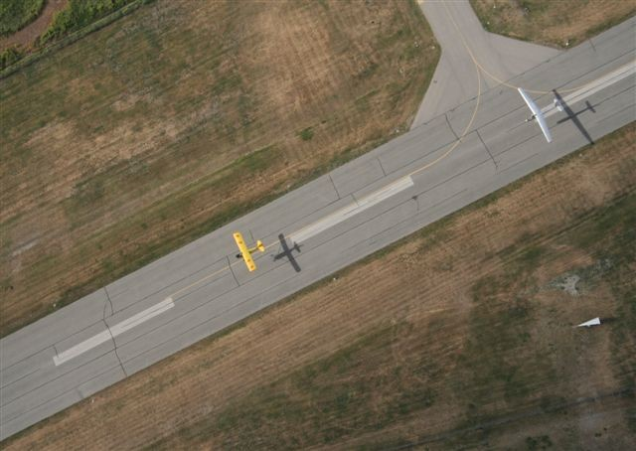
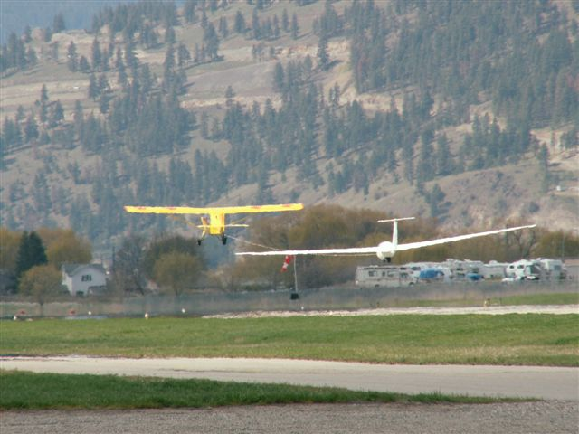
The standards include:

Slide 9
Instructors must demonstrate a high level of safety practices and attitude on the course. Peoples’ lives will be entrusted to your tutorage. This has to be your main priority, both for safety of the flight (your attitude and habits) and ingraining the safety attitude and behavior in your students. There are no compromises in this area. There will be more about safety pitfalls later in this briefing and how to be prepared for what can go wrong.
Safety

Slide 10
Airmanship Skills
Candidates must adequately demonstrate an air exercise so that a student can repeat it. This “duplicable” exercise means the parameters of flight will not require the student to use exceptional skill to complete.
Notes:
For example if all landings are done with full spoilers on approach to demonstrate a normal glide angle the student will not be able to compensate for an overshoot without exceptional skill/effort.

Slide 11
Airmanship Skills -continued
The second aspect will be to analyze the student’s performance and recognize when further development exercises may be required (detection & correction of obvious errors for Level III).

Slide 12
Pedagogy
Instructor Demo/practice methodology
Performance measurement and recording
Dealing with learning preferences/ instructor bias
Briefing and Debriefing
Checklists
Preparatory ground instruction
Walk around
Notes:
- Demo with explanation, then have student practice with verbal support or a silent demo, then demo with explanation, then student practice with verbal support?
-Watching what student does with the controls not just what the aircraft does. EG spin recoveries, gentle turns, aero-towing
Anticipate the correct movement on the controls, then look for movement in periphery or touch controls gently to feel movement

Slide 13
Testing
Standard for conduct of testing in Designated Flight Test Examiner Manual TP 2654E
SAC recommended Standard for GPL
SAC Solo Standard for glider pilots
Soft skills - situational awareness, self-assessment and intuitive intelligence
GPL is standard to take passengers – you should feel comfortable sending a family member with the pilot you just passed.
Notes:
Soft skills for Solo
In order to assess these skill on how the pilot handles stressful situations with appropriate reactions the instructor needs to evaluate:
Does the pilot anticipate problems?
Does the pilot prepare for these events?
Does the pilot recognize that some of their actions may create future problems?

Slide 14
Human Factors Integration
Ground School
Preparatory Ground Instruction
Pre Flight Briefings
In-Flight Instruction
Post Flight Briefings

Slide 15
HF Examples
Vision limitation/Scan techniques & illusions in flight (myopia, drift)
Decision making models/Use in flight (SOAR, PAVE/CARE/TEAM, WROLL, SSSLOW, IAMSAFE, CALL)
Physiology/Disorientation (Coriolis effect, spatial disorientation, G, air sickness)
Physiology/Effects on flight (fatigue, hypoglycemia, dehydration, hypoxia, temperature, barotitis, barosinusitis, bends)
Communication errors/CRM/SRM
Personality factors/Effect on flight (attitude, attention to detail, self discipline, responsibility, self evaluation, stress reactions, fear, heuristics)
Control design/Errors made in flight (spoilers, gear, instruments, primary controls, body& seat position, radio, compass)
Checklists/Checklist error(s) made in flight
Notes:
Barotitis - Damage to middle ear by pressure changes
Barosinusitis – damage to sinus caused by pressure changes
Bends – depressurization (altitude) causing nitrogen to be released from blood into tissues
Coriolis effect – Movement of the fluid in the inner ear in the circular canals creating sensation of movement
Olith – inner ear hair like organ with a mass at the end that senses accelerations
CRM Crew resource management
Single pilot Resource Management – Situational awareness, Fatigue management,
Heuristics traps – rules of thumb we use to make decisions and the traps that we can succumb to.

Slide 16
HF Summary
Practice what you preach - be the example
Take a deliberate approach to HF education and incorporate it into training
Look also for opportunities to bring HF to students attention
Develop self awareness in students
Assess HF to provide feedback to improve student behaviour

Slide 17
Safety Integration
Safety attitude and culture
Generative safety culture
Part of all aspects of training
Ground School
Preparatory Ground instruction
Pre flight briefing
Flight Instruction
Post flight debriefing
Deliberate safety training program
Proactive vs reactive

Slide 18
Safety Training Checklist
SAFETY TRAINING AND ORIENTATION PROGRAM
* Annual recurrent training recommended
SAC Safety Program and documentation
Club Safety Program
Safety Reporting System
Hazard/Risk Identification Process (proactive)
Safety Culture (generative)
Operational Safety
Flight line operation
Aircraft handling
Safety book
Maintenance safety
Parachute care and use
Glider trailer use
Winch operation and risks*
Safety/emergency equipment
Daily Inspections
Positive control checks
Emergency response plan
Tow recovery vehicles
Safety Audits
Tow plane operations
Refueling operations
Flight Safety
SOAR technique
Collision avoidance*
Limitations of the eye
Limitations of perception
Scan techniques
Blind spots (gliders & power)
High risk areas
PowerFLARM use
Stall/spin avoidance*
Flight configuration risk/symptoms
Incipient/wing drop recovery
Full spin/spiral recovery
Use of checklists
Options in CISTRC-O
SRM
Flight notification procedures (SAR)
Contacts while airborne (FIC, ATC, etc)
Fatigue management planning (risk management matrix)
Work load management (sterile cockpit)
Decision making (P3 & SOAR, WROLL, IAMSAFE)
Situational Awareness (perceives, understand, predict)
Human Factors*
Effects of stress on decision making
Biology of stress (heart rate)
Heuristics awareness/personality factors
Oxygen use
Physiology effects
control design/errors
Preflight inspections
Club General Safety
Facility maintenance equipment and vehicles
Pools and recreational facilities
Fire and first aid, ambulance
Hazardous chemicals
SAC/Club Accident/incident reviews/discussion
Notes:
Sticker in back pages of PTR

Slide 19
Feedback
Ask for questions after all briefings
After a practical flight lesson ask the student “how the lesson went?”
Use good question techniques, no yes or no answers
Mentorship- assign one instructor to each student to review progress and get feedback, understanding student may have several duty instructors. Record in PTR
Assign several instructors to one class I instructor to mentor instructors and get feedback from instructors
Use student PTR for reviews/feedback
CFI feedback to FTSC

Slide 20
How to Avoid Training Accidents
How to avoid take off problems
How to avoid undershoots
How to avoid hard landings
How to avoid PIO in landings
How to avoid stall/spins
How to avoid not returning to the airfield
How to avoid mid-air collisions

Slide 21
How to avoid take off problems
Good pilot/passenger brief on seatbelts, how to exit, and emergencies including what to hold on to (shoulder straps) during takeoff. What not to touch (anything red). Don’t explain that they will release on intro flights until at circuit height.
Pilot walk around before take off can identify potential lethal problems.
Use trained wing runners to double check dolly off, air brakes closed, canopy closed, tow rope clear in addition to “all clear.”
Perform a review of options with a checklist and have a plan for emergencies appropriate to conditions and terrain. Suggest “are you ready to WROLL” – wind, release, obstacles, landable areas, and launch interruptions.
Top ten reasons to release: lose directional control; wing drop; slack in rope; over run tow rope, tow plane loses power; obstacle appears; canopy opens; not airborne by mid point; lose sight of tow plane; and any safety concern.
Wing drops result in ground loops avoid temptation to save – release
Canopy unlocking during take off, fly the airplane and don’t let distraction lead to uncontrolled flight, release and land then fix. Slight side slip into hinged side will help.
Respect x- wind and weight and balance limitations.
Control the decision to release in training for emergencies and do not delegate to student or tow pilot – you may not be in a good position/timing for recovery.
Take control early if directional control varies more than about 10-15 degrees off runway centerline as tension on tow rope may cause wing to roll towards ground.
Use tow rope 200’ in training as gives student/instructor more time to react and reduces chance of tug upset.
Always take control in real emergencies.

Slide 22
How to avoid undershoots
First good demonstration circuits by instructors are required.
Make a habit of demonstrating your approach by planning to use ½ to ¾ air brakes on approaches (center of approach funnel). This allows students to be above or below a normal approach.
Have students pick a reference point far enough down the landing area to provide a suitable land-able undershoot area.
Teach students they must first establish an overshoot before they open air brakes (ref point moves down in field of view).
If detecting an undershoot on the approach (reference point moving up in field of view), teach them to close air brakes and re-establish overshoot then open only enough air brake to prevent overshoot by keeping reference point steady (not moving up or down).
Teach a stabilized approach (airspeed and rate of descent constant to reference point)
Have students practice over/undershoot control before teaching approach in the circuit.
As the instructor, be prepared to stabilize the approach if the student does not adequately respond to verbal cues.
Instructor must monitor the approach throughout (no distractions).
Have student check speed control often (every 3-4 sec) during the approach.
Teach how to identify wind ground speed at circuit altitudes.
Teach when and how to modify the circuit and not get lulled into using ground reference to judge turn to base leg (most common issue on windy days).
On strong wind days make base turns within the runway boundary fence.

Slide 23
How to avoid hard landings 1
Stay in your comfort zone to take control in time and know your personal limits/capabilities.
A stabilized approach leads to good landings, un-stabilized expect problems. (air speed and rate of descent constant while on correct glide slope to reference point)
Monitor the approach speed & rate of descent keeping the student’s approach speed at or over the minimum approach speed. High rate of descent and low air speed is high risk for hard landing.
If full air brake is used on approach, have the student reduce the air brake to ½ to ¾ (depending on their effectiveness) into the round out. Many instructors have been taught to use full spoilers for the round out, but this has caused more problems with accidents. As modern gliders have more effective air brakes now, the method described here is preferred. In short field landings increasing the air brakes after the start of the rotation (once the descent is checked) to minimize the hold off can be taught to advanced experienced students.
When approaching the ground before rotation, instructors should keep their hand low and loosely around near the base of the control stick ready to grip it if needed but not interfering with the feel of the controls for the student. The stick may be moving wildly at a critical moment and difficult to grasp.
Place a hand or fist on fuselage side wall before round out to block air brake handle travel if student attempts more than ½ -¾ air brake during round out and hold off. Student opening when intending to close air brakes is common leading to hard landings or stalls.
Monitor height of rotation and if too high get student to lower nose slightly to correct height and flare again. If airspeed is too low take control.
If rotation is late take control and close airbrakes immediately. No discussion except “I have control”, leave yourself enough time to save the landing.

Slide 24
How to avoid hard landings 2
Height loss side slips should be recovered at 100’ in early flights. If student can consistently do stabilized approaches and speed control in slips this can be lowered to 50’ in light winds.
Wind shear has caused problems and instructors must watch for signs and approach slightly faster depending on strength of gusts (See POH for recommendations, if none exist add gust factor to approach speed). Be prepared to take control as higher risk of a hard landing. Signs of possible wind shear include:
Wind speed or direction variable.
Difference more than 5 kts in wind speed in gusts.
If there is a x-wind and it is gusty.
If wind shadows exist at the field.
Wind and obstacles on the approach path.
Wind comes from a direction that is not usual at you home field.
Strange lower cloud formation present such as roller clouds.
Watch out for student trying to land too fast (insufficient rotation)and/or not holding off landing.
Watch for student trying to plant the main wheel on the ground (moving control stick forward in hold off.) See section below on PIO and Wheel Barrowing.
During tail wind landings monitor airspeed closer as student may try to slow glider.
Rain or other wing contamination may increase stall speed dramatically. Be cautious with air brake use and additional airspeed may be required.

Slide 25
How to avoid PIO
Understand why PIO (Pilot Induced Oscillations) occur including impact of Weight & Balance. Most PIOs occur on takeoff.
To avoid PIOs on landing tart with a stabilized approach.
Teach students to rest arm on lap so that only the wrist action controls the stick motion (proper seating).
Student should be looking at far end of runway towards horizon before rotation and hold off (common fault if landing difficulties).
Use at least ½ air brake in the round out and hold off making the glider less pitch sensitive.
Teach student not try to plant the main wheel on the runway (wheel barrowing); and hold off until minimum energy before touch down; open full air brakes once the main wheel has settled on the ground (as student perfects landings you can introduce opening airbrakes gradually in the round out and hold off with full air brakes).
In a x-wind touch down slightly faster than minimum energy landing.
If PIO starts have the student stop moving the stick in the center for a second or two to let the glider settle (fly level) and rest their arm on their lap again and raise or lower the nose with pressure control as appropriate.
The instructor should be prepared to hold the stick steady for a second or two if the student is having other than minor difficulty with PIO and then transfer back after student rests arm on lap.
Instructor should take control anytime a PIO is moving towards an unsafe situation. Intervene earlier rather than later as little is being learned once student is in anything other than minor PIO. Scaring themselves will be detrimental to further progression. Oscillations to loss of control or ground impact can occur very quickly if instructor lets student try to recover other than minor oscillations.
Go back to simulator if problems with PIOs are repeated.
Watch for PIO sensitivity or over controlling in general in your students. (I.E. watch to see if they apply rapid control movements and counter movements in flying manoeuvers. Do they let the glider fly and use pressure control to move the stick/rudders or are they constantly making corrections for every control input. If so sort this out before they fly close to the ground. It is obvious from another glider looking at control surfaces during turns! Also known as churning the butter!)

Slide 26
How to avoid stall/spins
Teach that the glider will spin if stalled with a yaw component (even a small amount of yaw) so understanding is the first step to prevention. Un-stalling the glider before a spin will prevent spin.
Teach students to feel how the glider is flying and what it is doing not just what they see (instruments/attitude). Practice speed control with air speed indicator covered. However emphasise that feeling airspeed is unreliable near the ground so constant reference to airspeed indicator is needed after base turn.
Emphasise the 7 indicators of an approaching stall and correct recovery in any attitude is to reduce angle of attack by lowering nose. Explain that indicators may occur very quickly in some scenarios so prompt recovery action may be required. They may not notice a warning indicator.
Make them familiar with the 12 spin scenarios in gliding and how to avoid them.
Practice turns with tailwind and x-winds to get accustomed to illusions created by drift and correct techniques for coordinated turns. Some minor slip is better than any into turn extra rudder at low altitudes.
Gusty conditions require extra air speed to manoeuver safely.
Practice spin recoveries in simulator first and then in glider until student is comfortable handling them. Low altitude scenarios can be practiced in simulator.
Practice correct approach speed and maintain correct speed in the circuit (see POH for glider). If speeds are not identified use technique identified in SOAR manual.
If no type specific spin recovery technique identified in aircraft manuals (POH) use standard recovery technique in SOAR manual.
Slightly slipping turns are safer than even a slight over use of rudder in turns.

Slide 27
How to avoid not returning to the airfield
Early in training establish boundaries for local flying that have safety margins for sink built in to return to the field (minimum sector altitudes). In stronger winds have them stay upwind of the airfield.
Teach distance to glide and range estimations using the eye and map. Practice flight towards next cloud and estimating anticipated height loss using L/D, including into wind situations where speed needs to be increased for penetration.
Practice students in final glides and estimating glide angle to the surface (while maintaining safe altitudes). Student to pick point of contact with ground if glide is continued.
Teach what to look for in clouds to find lift and actions to take in sink.
Have a glide calculator in glider and demonstrate its use.
Teach how to be observant to changing weather patterns and fronts and the effect on winds/gusts and available lift (include basic cloud reading).

Slide 28
How to avoid mid-air collisions
Understand the limitations of the human eye and eye sight. (see CFI for PPP on Collision Avoidance)
Practice and Teach correct scan technique to overcome many of the limitations.
Demand a correct scan technique from students before all maneuvers by stopping execution of a turn if scan was not done adequately.
Teach the seven types of lookout.
Use all available eyes and establish dialogue with student/passenger by alerting each other about traffic and state out loud “clear right/left” when making turns to indicate the pilot has not seen a conflict.
Avoid the third glider trap (once a glider is located don’t assume another threat is not present).
Monitor and use a radio correctly and avoid temptation to turn off or down the volume so you can’t hear it when teaching.
Use the radio for position reporting (follow MF discipline) and your intensions especially if executing non-standard pattern of maneuvers.
Identify high risk collision areas for your students including airline traffic lanes and below your flight path in the circuit and how to look there.
Use PowerFLARM to identify conflicts and react appropriately when collision imminent (no reaction will result in collision).
Teach proper look out for thermal entry/exit procedures and thermal etiquette before first solo.
Use 126.7 for x-country position reporting and switch to 123.4 glider frequency only when you wish to chat.
Although not avoidance, wear a parachute for when all else fails. Remember the area around the aerodrome and circuit are the most dangerous.

Slide 29
SAC INSTRUCTOR RATINGS
CLASS II
Prerequisites
-Class III rating
- time & experience
- CFI recommend
Standards (update)
Curriculum (update)
Solo Discussion
- solo standards
- Soft skills
CLASS I
Prerequisites
-Class II rating
- time & experience
- CFI recommend
Standards (update)
Curriculum (update)
Licence standards
Test standards guide
Conduct of Flight test (air exercise)
Leadership discussion
Authorised Person training
Notes:
Class II Solo soft skills assessment – identification and how to assess in students
A skill demonstrated once can be luck, twice coincidence, three times in a row a pattern!
Class I are best accomplished through assisting with the instructor course.
Class I leadership discussion based on case studies and wisdom from past CFIs
Authorised person training is provided by TC not SAC
CFI recommendations (we expect that this recommendation is based on flying with candidates & supervision of their prerequisite time and experience, not the throw at the wall and see what sticks approach.)
Note instructors are the method by which SAC maintains standards – our accident history directly relates to how well we do this.

Slide 30
Conclusion
Standards (what where why & how)
Curriculum,
pedagogy,
testing,
safety & HF integration,
feedback,
problem areas
Instructor Class
How to avoid training accidents – Teaching standards

Slide 31
Questions/Discussion?
Are we all on the same page?

Slide 32
Syndicate Discussion
Do we need standards?
Who should set SAC standards?
What needs to be standardized?
What further actions are required?

