Slide 1
DEALING WITH EMERGENCIES
FLIGHT SAFETY
Prepared by SAC FTSC

Slide 2
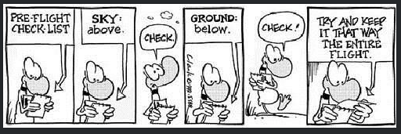
The solution to our challenge
What we don't want to happen!
://www.youtube.com/watch?v=cX4oFDEKm94

Slide 3
TWO DAY TRAINING PROGRAM
Some safety theory and why some emergencies occur (lessons learned in blood!) Best done at a social the night before and takes 2 hrs for the material and 3-4 hrs if there is lots of discussion. Especially if many of the concepts are completely new.
Practical scenarios (SBT) and exercises to develop skills to reduce impact of emergencies.
We cannot train for all possibilities but we can learn the basic techniques, try to stay calm and apply accident prevention methodology – Airmanship.
Fatalities are due to stall/spin and mid air collisions while most accidents are landing and take off.

Slide 4
CONTENT
A - Discussions – Theory and scenarios in emergencies
Airmanship & safety Culture
Off field landing techniques to avoid common accidents and overshoot protection
Common approach spin scenarios – after rope break, turns with tail winds, stretching glides, wind shears, overshooting centerline, pear turn (videos), quick reversals
Flying Flapped gliders – windy conditions
Ground loops
Tow plane upset scenarios including top ten reasons to release
Stress Management – cause, detection, prevention
Collision avoidance ,visual limitations, high risk scenarios and PowerFLARM effective use
Human Factors scenarios – analysis and mitigation P3 and using “PAVE”
Mountain Flying – hazards and techniques
“Is your glider fit for flight” – BGA brochure review cause and prevention PCC, CAC
Cloud flying techniques for gliders
Systems approach to safety
Local Issues

Slide 5
CONTENT
A - Practical - Flying emergency situations using Scenario Based Training
Control Failures, Elevator, Rudder, Ailerons, Airbrakes, landing with full airbrake/no airbrake, instrument failures
Rope brakes: basic technique, various altitudes
Tow plane upset: lateral and vertical situations
Slack rope recoveries: lateral and vertical situations
Overshoot recovery technique (European)
Using shallow slips to stay behind tow plane when low and when avoiding obstacles after the round out
Stall/spin on Approach – Drift Illusions, cross control, pear turn
Stall/spin on rope/cable breaks (low spins on simulator)
Stall/spin scenarios –(15) including gust stall induced spins on approach or in mountain (simulator)
Coping with wind shears and bounced landings (simulator)
Gaggle Flying and FLARM Drills (simulator)
Benign spiral and cloud flying (simulator)
Parachute egress drills practice (staging a glider with wing stand and foam mattress, two people to hold canopy on release and hand timing person)

Slide 6
Dealing with Emergencies
Key to emergencies is avoiding them in the first place
Second - you want to plan how to deal with them
Third – you want to practice to build up confidence
You can’t practice for every event but you can learn some techniques
Does your club train to the minimum to pass the exam or do they train for maximum safety?
Are you a fair weather flyer? Leaves you unprepared for difficult conditions!
How do you personally approach safety in general
Use a cell phone while driving?
Wear a bicycle helmet while riding?
Examine your attitude and what is your pay off for not reducing the risk?

Slide 7
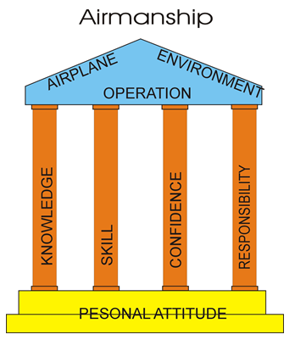
Airmanship
Ultimately we are human. We are subject to human drives. So maybe there is another definition to airmanship — the self-discipline and wisdom to rise above our human condition and just be practical about what we do and where we do it.
This is where most of us go wrong
Tony Hayes

Slide 8
Airmanship – Guard against:
Hazardous Attitude |  | Antidote
Anti-authority | ‘The regulations are for someone else’ | ‘Follow the rules. They are usually right.’
Impulsivity | ‘I must act now, there’s no time’ | ‘Not so fast. Think first’
Invulnerability | ‘It won’t happen to me’ | ‘It could happen to me’
Macho | ‘I’ll show you. I can do it’ | ‘Taking chances is foolish.’
Resignation | ‘What’s the use?’ | ‘Never give up. There must be something I can do.’

Slide 9
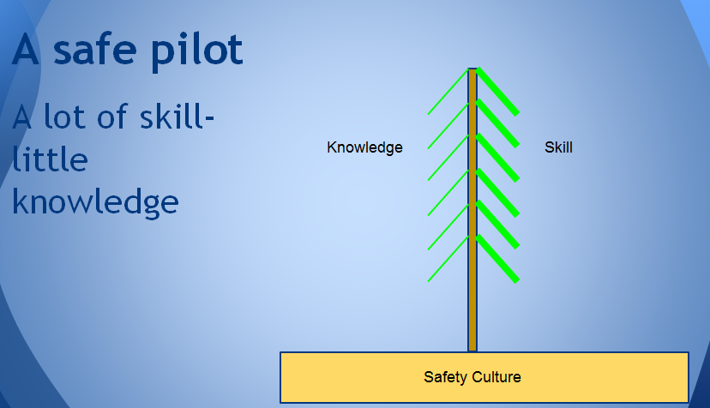
Norwegian Airmanship Model
Or lot of knowledge little skill – the tree will bend but not break if the stem is strong! A strong safety culture promotes strong roots and core for Airmanship.

Slide 10
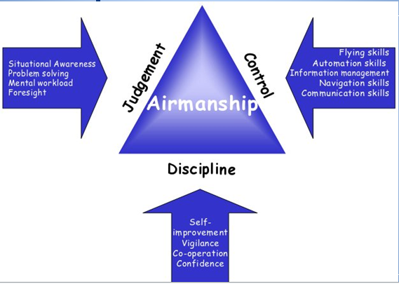
Airmanship

Slide 11
What is Safety Culture?
Lethal :
little attention and focus on safety matters. Tendency to ignore safety issues
Avoidant :
Strong tendency to distance oneself from any proactive actions & requires something to “happen” before there is any real recognition that safety is deserving of attention. Safety is a bit of a game.
Developing :
safety communication has begun & encouraged to actually raise safety concerns but not necessarily being acted upon. Recognising the value of safety & recognition of “risk” in the club.
Functional :
Safety performance is frequently recognized throughout all levels of the organization. Conversations occurring focused upon the safe way of getting things done. More pro-active and interpersonal approach to safety.
Transformational:
vast majority are working together in matters involving safety performance. Strong recognition, backed up by behaviour - safety is never to be compromised. Job done safely surpasses job done quickly every time. Focus on learning’s from incidents “learning organisation”. The “norm” to consult when there may be process changes
What is your organization? Where do you want to be? Airmanship?

Slide 12
Off Field Landing Exercise
Always have a plan where to go and minimum altitude floor where you are flying to get to suitable landing area. (really important in mountains and to increase safety altitudes for sink)
Know your personal thermalling minimums and adjust upwards for turbulent conditions (rec 500’ minimum with no turbulence for experienced x country pilots)
Alternate landing area reachable from down wind
Pay attention to V approach = (1.5xVs + ½ Vwind + Vgust)
Plan circuit backwards but be prepared to adjust to conditions and modify as needed

Slide 13
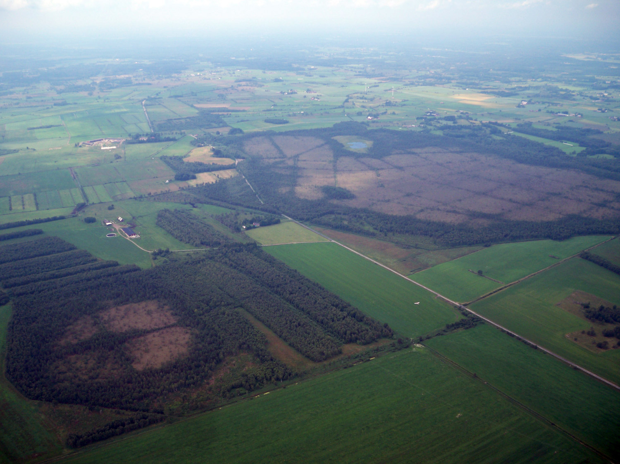
Mental picture– try to see:
(talk backwords)
Where to stop the glider in the field
Touchdown point
Height over last obstruction
Final
Base
approach speed
High key
Downwind
Reduce hight
Check field etc.
1000 ft
800 ft
100 ft
500 ft
300 ft
400 ft

Slide 14
Overshoot Protection
Modern gliders with airbrakes more effective than forward slip to lose height
Problems with wind gradient and un-banking or high obstacle off field landing
Forward slips to lose height risk striking wing on ground. Most European countries use technique as follows:
If too high on approach and overshoot likely, open full airbrake
Increase speed to 65-70 kts drag increases with square of speed angle of approach lower than 5:1
Decrease air brake and return to normal approach speed and angle if undershoot develops
Hold speed and airbrake into round out and then short hold off allowing speed to decrease, then touch down and use wheel brake to minimize ground run
https://www.youtube.com/watch?v=X7T3UHkUMME

Slide 15
VIDEO – DG 500 ACCIDENT
Observations or dropbox link https://www.dropbox.com/s/krsxkox9he9e19a/DG-500%20Spin%20Accident%20%28Clean%20not%20spiolers%20open%20just%20before%20spin%29.avi?dl=0
Briefly describe what actions were taken by the pilot. Note wind, airspeed, airbrakes
Was the action appropriate or did it make things worse?
What should or would you have done better?
What important lessons are learned for future use?

Slide 16
Common Approach Illusions Turn after a rope break (headwind component)
4 - Tail wind pushing glider gives higher ground speed creating illusion speed increasing and pilot subconsciously slows glider
3 - Wind pushes glider into turn giving illusion of slip. Pilot subconsciously corrects by pushing left rudder skidding glider
wind
2- V approach established and turn started
5 - Pilot perceives glider is overshooting and opens air brakes and glider stall/spin
1 - Rope break occurs and turn started before airspeed increases above 2g stall speed leading to spin or …

Slide 17
VIDEO – Airshow Accident
Observations https://www.youtube.com/watch?v=zxbulrrQVig
Briefly describe what actions were taken by the pilot. Note wind, airspeed, airbrakes
Was the action appropriate or did it make things worse?
What should or would you have done better?
What important lessons are learned for future use?

Slide 18
Common Approach Illusions Lets look closer at Skidded Turn Aerodynamics
Relative wind
In co-ordinated flight relative wind is perpendicular to airfoil. Critical angle of attack is reached near root first due to twist in wing. On swept wing, stall starts near wing tip first due to relative wind being offset. In turns lift vector turns glider.
1- Pilot realizes an overshoot of runway and banks to turn back to runway to maximum bank angle comfortable with.
2- Uses rudder to increase rate of turn but nose is yawed downward. Relative wind hits wing at an angle in resulting skid. Lower wing is similar to swept wing aerodynamics.
3 - Secondary effect of rudder rolls glider and pilot applies opposite aileron to prevent over bank and is cross controlled
4 – Lower wing is producing less lift in skid and starts to drop and increase angle of attack closer to stall.
5 – lift vector does not change with increased rudder so turn rate does not improve ,but nose is starting to point towards runway. Pilot may feel better but still overshooting turn!

Slide 19
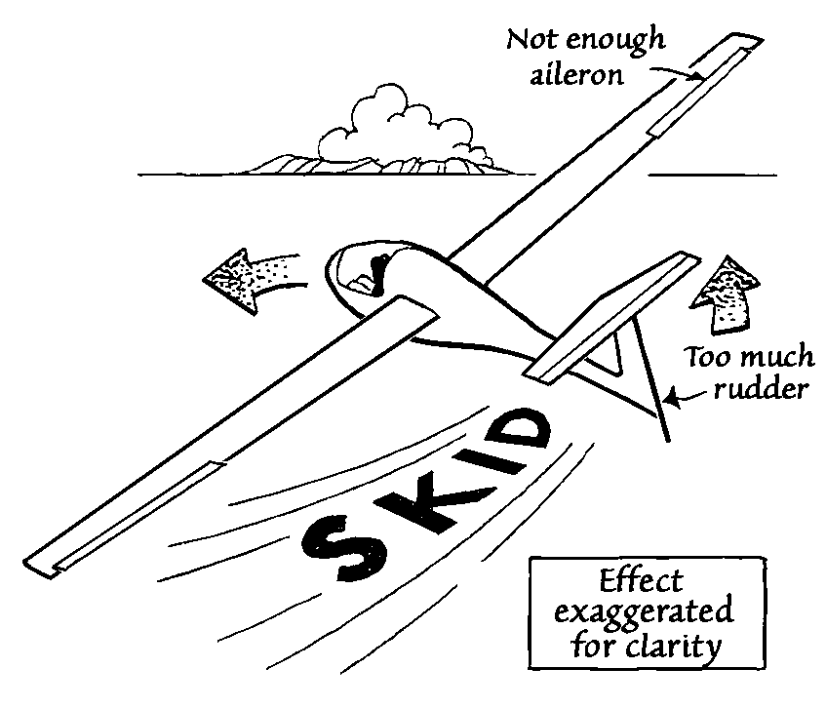
Skidded Turn Aerodynamics
6 – Pilot adds more rudder to turn and more cross control to prevent bank effect. Drag increasing and nose wants to drop and pilot attempts to prevent drop by pulling back on stick.
Lifting moment arm center of pressure
7 – As stall is approached the lifting moment arm moves the center of lift outward on outside wing and inward on lower swept wing due to relative wind direction. As wing stalls, aircraft will roll inverted to the inside due to uneven lift*. From inverted most pilots attempt pull out to level wings. At low altitude several hundreds of feet required to recover this way.
See U-tube skidded turn aerodynamics – APS Emergency Maneuver Training by Clark McNeace https://www.youtube.com/watch?v=PMhoPJYCvXA
Relative wind
Higher angle of attack and swept wing to relative wind, tip stalls first
*Some modern gliders have ailerons that are effective in the stall and they may not reproduce this effect.

Slide 20
Skidded Turn Prevention
Avoid situation by keeping yaw string straight
Keep airspeed at V approach check often every 3-4 sec
Avoid increasing g loading beyond 2g (60°)
If glider stalls reduce angle of attack immediately to regain airspeed and pull out of dive.
If inverted do not pull back, but roll upright then pull out of dive.

Slide 21
Common Approach illusions Wind shears
Conditions may appear good aloft but????
Look for signs (200’-300’ height loss not uncommon)
Gusty conditions, turbulence, dust devils, wind sock variations, winds aloft difference from surface winds, strong thermal conditions, inversions, cross wind obstacles such as buildings, trees, etc…
Use approach speeds recommended in AFM or (1.5xVs +1/2Vw+ Vgust)
Flapped gliders should not use landing flaps in gusty conditions or strong winds (consult AFM) Typically slowing to apply landing flaps is risky for stalls
Some modern gliders such as ASW -27 may enter a spin or spiral if abrupt full control movements made on approach

Slide 22
Approach Illusions
Sloped up or down runway pilot flies too low or to high
Wider or narrow runway pilot flies too high or too low.
Turns from a tailwind (skid illusion) pilot slips aircraft
Turns into a tailwind (slip illusion) pilot skids aircraft
Tailwind, pilot flies slower
Illusions are visually stronger at lower altitudes
If distracted or under stress pilot will not notice that they unconsciously react to illusion.

Slide 23
Flying Flapped Gliders
Approach speed appropriate
POH check flap setting speeds
Max extension speed typically lower than min approach speed on windy days
High performance airfoils susceptible to stalls with little warning
Some gliders (ASW 27) full movement of controls must be avoided as can induce stall
High performance gliders appear to be more susceptible to gust stalls
Follow POH for minimum approach speed Typically around 1.5 Vs + 1/2Vw - Vgust

Slide 24
Ground loops
Major causes:
Wing drop or wing drop stalls on take off or landing including winch (poor cross wind technique, not anticipating prop wash, yawing of nose without reacting on ailerons)
Approach speed too low in landing normal attempts
Often trying to land short so glider in high angle of attack
Over use of brake with C of G behind wheel particularly with MG
Catching tall grass or crops with wing tip on landing or takeoff
Hard landing not symmetrical (usually slow approach with high rate of decent
PIO or “Porpoising”

Slide 25
Ground Loops
Mitigation:
fly appropriate approach speed, control rate of decent and avoid excessive braking to land short – roll out
Assess crops and long grass and avoid and release when wing drops to contact ground.
Holding a landing attitude with some air brake open 1/2 to 2/3
Holding a take off attitude, not coaxing glider into air

Slide 26
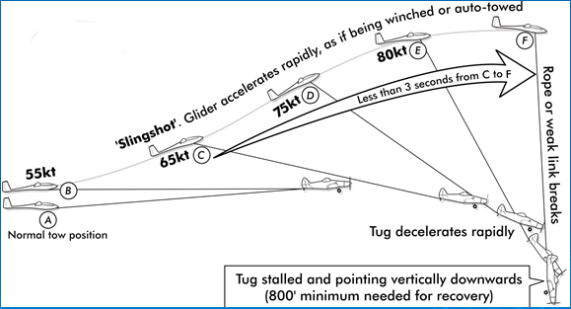
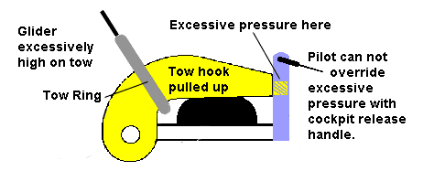
Tow Plane Upset
If you are inexperienced, do not aerotow on a belly hook and do not aerotow in turbulent conditions.
Maintain the correct vertical position of the tug in the canopy. Do not allow the glider to get too high.
If you are too low behind the tug shortly after the tug take off, or at any other time, move back into position SLOWLY. Being lower than the tug is not dangerous. An upset can follow if you pull up quickly.
Release immediately if the glider is going high and the tendency cannot be controlled or you lose sight of the tug.
Fly the glider! Leave any potentially distracting problems with instrumentation or ventilation until after release. Leave the undercarriage down.
At release height, is it clear? Pull the release, visually ensure the rope has separated from the glider and turn away from the tug without a climbing turn.
See Video simulations:
https://members.gliding.co.uk/bga-safety-management/safe-aerotowing/

Slide 27
Top Ten Reasons to Release
Lose directional control;
Wing drop;
Slack in rope;
Over run tow rope,
Tow plane loses power;
Obstacle appears;
Canopy opens;
Not airborne by mid point;
Lose sight of tow plane; and
Any safety concern
Pilots tend not to release when things go wrong in the hope they can salvage the launch until its too late!!!
Release while you still have runway available.
Has lead to fatalities

Slide 28
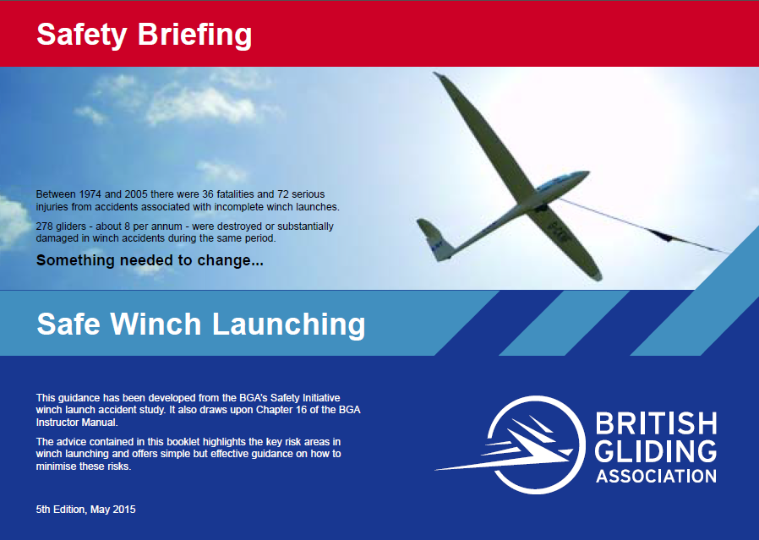
Winch Emergencies (optional)

Slide 29
Winch Emergencies
Too high rotation rate – Flick stalls
Too low a speed for breaks less than 50 kts
Failure to lower nose quickly and opening air brakes too soon – stall
Wing touching ground – ground loops
Problems simulating emergencies in training below 100’- use power loss only no cable brake simulation – fly into chute
Use overshoot protection if too high or mod circuit
Wing Runner signal stop if wing touches ground

Slide 30
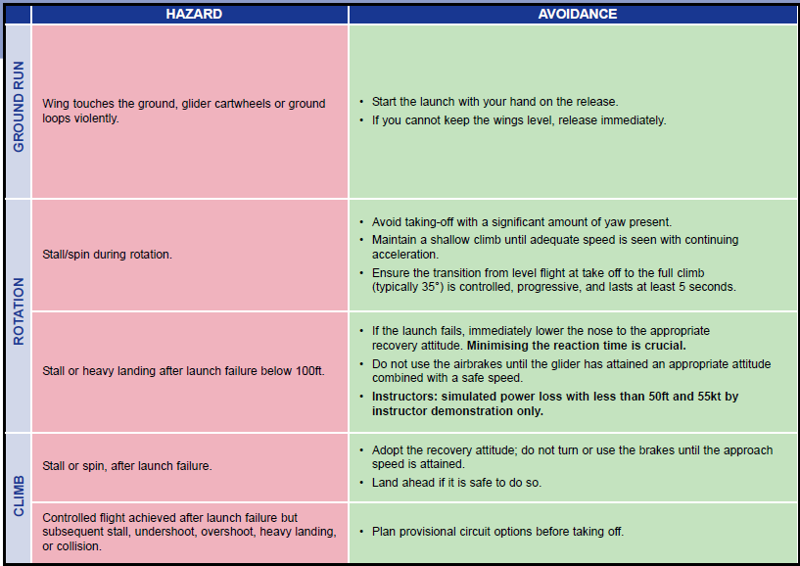
Winch Emergencies Prevention
See video link below
cartwheel after a wing-drop
accelerated stall and flick-roll
spin after power loss
https://members.gliding.co.uk/bga-safety-management/safe-winching/simulations/

Slide 31
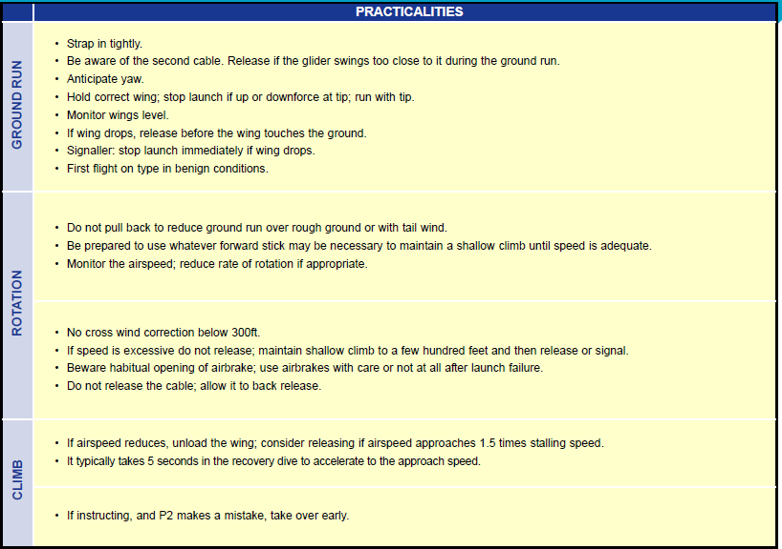
Winch Emergencies Prevention

Slide 32
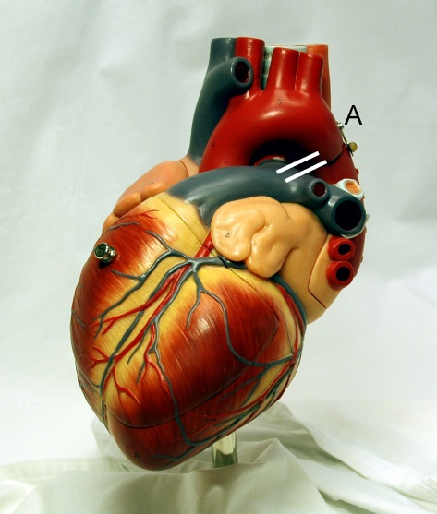
Stress Reactions
115 and 145 beats/minute heart rate
optimal state of "arousal"
> 145 bad things begin to happen.
motor skills start to break down
tunnel vision
aggressive behavior
175 breakdown of cognitive processing
fore brain shuts down (judgment)
mid brain takes over (unconscious reactions)
vision more restricted
>175 physiological control non-essential
Blood is concentrated in the core muscles
clumsy and helpless
Motor reaction freeze
Solution -- Stress inoculation (SBT)
Adrenaline can raise heart rate in seconds.
Notes:
From Malcolm Gladwell’s book “BLINK” where he quotes US LCol Dave Grossman’s book “On Shooting”
Q- Does any one no what I mean by the brains high function and low function?
High function – cognitive ability mostly frontal lobe
Low function – emotional responses, long term information/skill storage, learned behavior.
Learning to drive a car was high function, driving one for most of us, is now low function.
Q-What is the role of the AMYGDULA in the brain?
Controls emotional responses, low functions, and release of hormones like adrenalin.
Normal heart rate is about 65-75 and a work out over 120
ever heard of this in an accident report?
Situational awareness is gone!
I cal this the deer caught in the headlights! Adrenalin can move a pilot to over 175 beats in seconds.
Police and the military repeatedly expose members to stress situations to let the brain develop less emotional reaction. In glider training I suggest we can use Scenario based training to establish the neuro networks to move reactions from high function to low function without the emotional interference of the Amydula.
More detail on Scenario based training later.

Slide 33
Stress Management Stress Indicators
Heart rate increases
Start to push on both rudder pedals
Start to grip stick firmly
Breath holding
Difficulty thinking, aggressiveness
Tunnel vision, no thinking
Inability to move

Slide 34
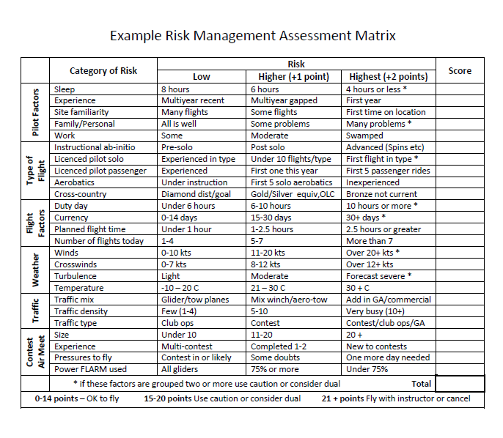
Have you seen this? The aim is recognize accumulative effects and potential risks

Slide 35
Stress Reaction Countermeasures
Scenario Based Training – Have a plan
Risk analysis of your level of stress
Force yourself to breath and relax
Take feet off pedals momentarily and relax muscles if possible
Relax grip on stick and try to slow heart rate
Fall back on training and use SOAR technique or P₃
Primary rule - fly the airplane
Try using Bio feedback device to measure stress reaction (EDS, Pulse oximeter, pedal sensors/buzzer)

Slide 36
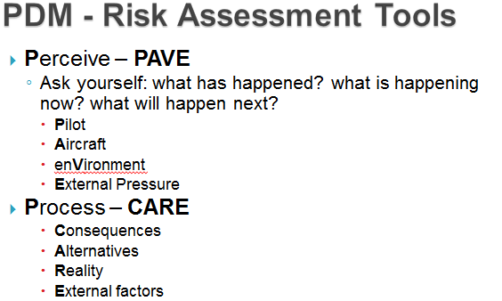
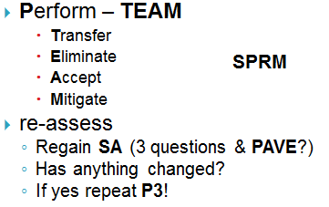
Stress Reaction Countermeasures
Similar to SOAR model
https://www.faasafety.gov/files/gslac/courses/content/28/200/3P%20Risk%20Management%20Process.pdf

Slide 37
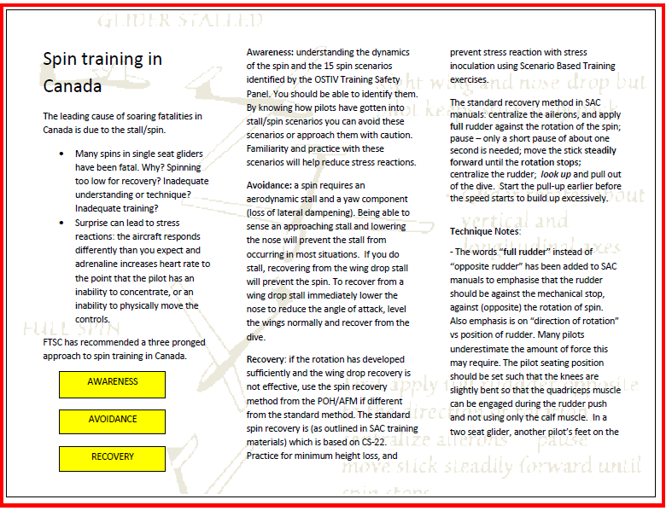
Have you seen this flyer? Why do gliders spin? Can a spin occur without rudder?

Slide 38
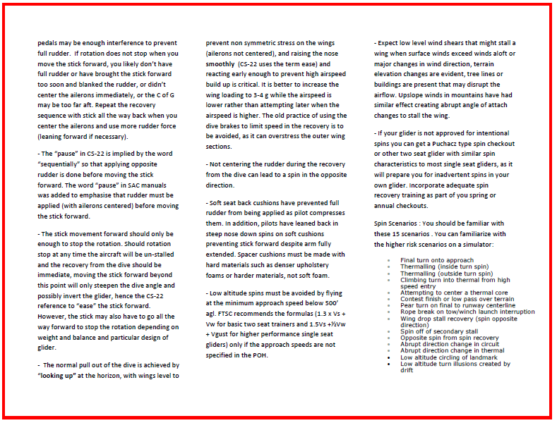

Slide 39
Flight Exercises
Flight 1 - Aero tow above 1000’ rotor type slack tow recoveries lateral & vertical (no airbrake); off tow 360 turns no elevator, or rudder, or ailerons; covered airspeed by attitude/sound; sim rope break recovery; overshoot recovery exercise.
If strong wind practice illusions created by drift by S turns crosswind at low key 600’ before overshoot exercise.
Flight 2 – practice sideslip on tow to adjust lateral position, spin exercises and simulated high sink at high key, practice avoiding obstacle on landing with side slips after rotation.
Flight 3 – Practice lateral slipping on take off to keep position, spin exercises and covered ASI for landing
Flight 4 – Rope break on lift off, land straight ahead
Flight 5 – Rope break at circuit height and 600’ with modified circuit
Flight 6 – Rope break at 300’ (200’ for experienced pilots & modern glider possible if good speed management)
Flight 7 – Spins, Begin spiral, no airbrake landing
Flight 8 – off field landing planning and execution

Slide 40
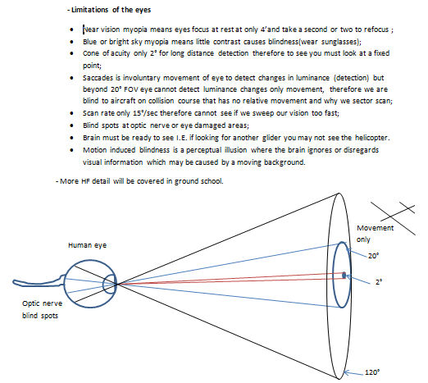
Collision Avoidance

Slide 41
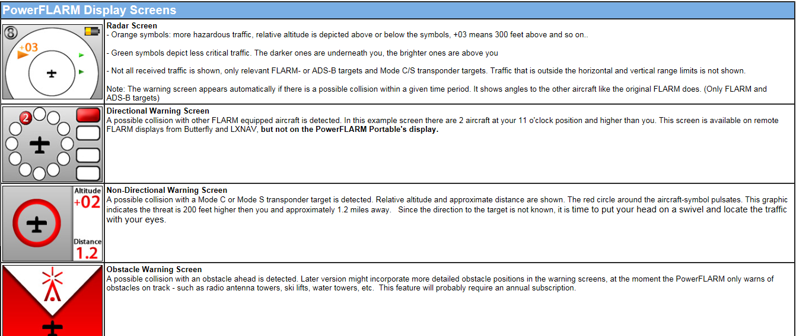
PowerFLARM Display
Source is from Cumulus Soaring web site

Slide 42
PowerFLARM DRILLS
Never assume FLARM gives the full situational awareness as another glider/aircraft may have their FLARM signal masked by carbon fibre in the aircraft, turned off, not functional, and/or not installed. Also never assume you are visible to other aircraft. Third glider trap.
In gaggle flying, as in any other mode of flying, keep a constant look out and avoid looking at the FLARM for separation information.
To maintain situational awareness remember PowerFLARM is a tool/aide to help and does not replace the principle of see and be seen, scanning techniques, radio position reporting on aerodrome traffic frequencies and 126.7 VFR enroute reporting frequency, and using a transponder in “Transponder Airspace” or near congested “controlled airspace”. Try to find threats visually before your FLARM does.
FLARM displays a threat relative to gliders position (clock ray) and angle above/below or on the horizon. When the glider is banked the threat is still relative to the earth’s horizon not to the horizontal plane of the banked glider.
Descending provides the most rapid separation from a same altitude conflict if no other traffic is below. Caution is needed if both FLARM equipped pilots descend. Visual contact should be established first if possible before maneuvering to maintain situational awareness. However, note that 85% of collisions occur from behind one of the gliders wings, often in decent or climb of at least one or both aircraft. Visual contact may be difficult.

Slide 43
If turning (right) away from a conflict aircraft, do not bank so much that you cannot maintain visual separation. Turning the belly of your aircraft to an imminent threat will put it in your blind spot and you cannot judge the separation. Do not underestimate how fast conflicts can close.
Transponders in gliders during gaggle flying will give many warning alarms due to proximity as FLARM is less accurate for mode C transponders (range is based on signal strength – this feature can be manually shut off on PowerFLARM). Reduce volume if too distracting, but do not shut off the FLARM. Increase volume when leaving gaggle. In a gaggle if visual contact cannot be made after an alarm and traffic above or below does not permit vertical separation, tightening the turn may help to reduce chance of impact for a threat closing behind you in the same turn direction, turning to the right may create a greater conflict in left turns.
Do not assume altimeter readouts are always 100% accurate although GPS altitude is used and errors should be uniform for other nearby FLARM units. Pilots are noting on the FLARM readout that the altitude difference is absolute and assuming the separation is adequate and dismissing the fact that relative altimeter errors are possible with any device. Also, the heading of actual threat may differ from display as based on GPS track. (professional pilots using expensive TCAS systems in airliners do not rely solely on the accuracy of their equipment, pilot flying follows TCAS and pilot not flying attempts visual confirmation if possible).
When a potential threat activates an “alert”, note the location, direction/ altitude differences and start a sector scan in the area to find the threat. Do not ignore the rest of the airspace or your situational awareness as you search for the conflict. Other non- FLARM threats may be present and imminent.

Slide 44
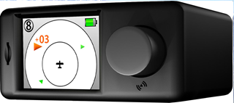
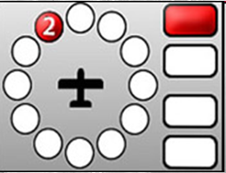
When an “alarm” is given of a potential collision your eyes will be drawn to the FLARM device, quickly note the position and look out in the direction indicated in the device to avoid the collision. If conflict is not seen make another quick glance to the PowerFLARM readout for location, then lookout in that sector again. Take appropriate collision avoidance action. As the alarm intensity increases, your current direction and speed is partly causing the conflict so some change is required. If appropriate, start a descent and alter course slightly and keep looking out in the required sector - after checking quickly on the FLARM – alternating between sector and FLARM until the threat is gone. The FLARM display should be positioned in your normal field of view.
Do not deliberately create a FLARM alarm situation. It is discourteous to the other pilot unless previous agreement/radio contact has been made to fly towards another glider to create an alarm. Best to use towplane FLARM on approach while glider parked on ramp to simulate actual alarms for training.

Slide 45
Human Factors Scenarios (2)
Read scenario (SBT)
Perceive the problem – what just happened, what is happening now, what is going to happen next
What are the major factors(PAVE)
Pilot, Aircraft, enVironment, External factors
What options for the pilot and are they appropriate or will they make things worse.
What should or would you have done better?
What important lessons are learned for the future?

Slide 46
Scenario 1
Bill is getting ready to launch and opens the canopy to call the wing runner over for the hook up. Tow plane pilot seeing the rope connected starts to take up slack slowly and Bill rushes his pre-flight checks. The wing runner gives all out and during the take off shortly after lift off, the glider yaws and the canopy opens. Bill grabs the canopy with his left hand. At this point the runway ahead is getting short.

Slide 47
Scenario 2
John Doe plans to do a 300 km task flight in is ASW 27. Conditions look reasonable but some pilots have been having trouble getting away after release due to wind gusts breaking up thermals and local sink. John does not want to miss a launch window so he assembles his glider and grids. The wing runner asks if he needs a PCC and he says he has auto hook ups. His wife reminds him not to land out because she can not go get him. After release at 3000’ he experiences high sink but sees dust devils from farmers fields 15-20 km and heads on task. On arrival the sink was much worse before he hit the dust devils but the lift is good but he is at 400’ agl. Unfortunately the thermal is narrow and turbulent and it is up on one side then down the other side. Down to 300’ he decides he must fly the core better by banking to 60° and flying minimum sink to reduce the radius as his field below does not look so good.

Slide 48
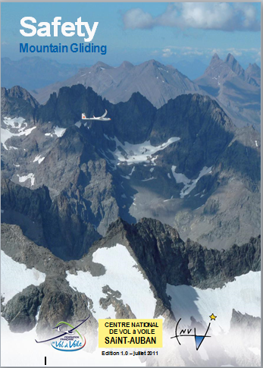
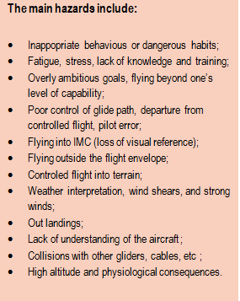
Mountain Flying (optional)
Coming soon “in translation”

Slide 49
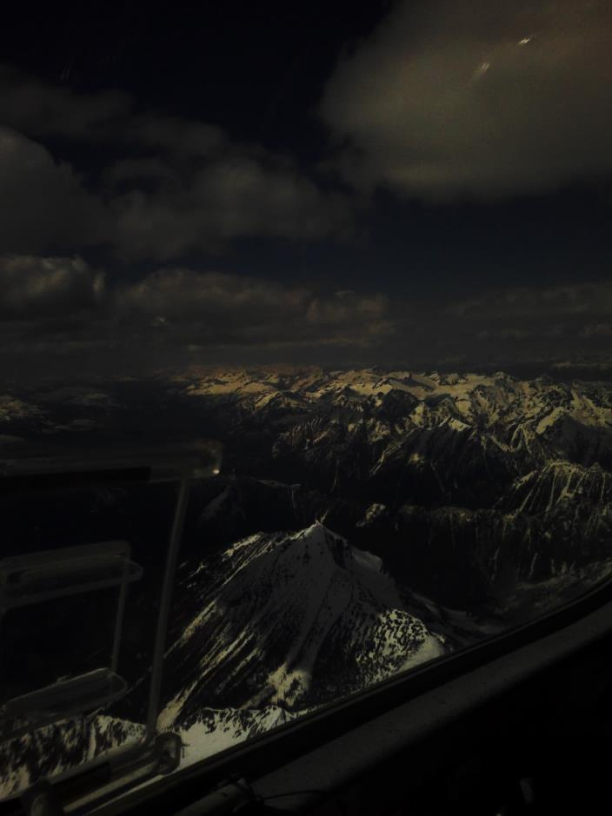
Mountain Terrain Factors
effects of prevailing upper winds and upslope flow.
difficulty in establishing sight lines, box canyons, etc
emergency landing options (lack of roads/cultivated fields, equipment required).
difficulty of interpreting weather conditions between reporting points.
downdrafts that can be created by warm air masses (Chinooks, etc) or cold air masses (CBs, also adiabatic air movement downward in thermals above glaciers [air avalanche phenomena] , etc) and diurnal winds.
pressure gradient winds in mountains.
mountain wave and leeward rotor throughout mountain areas.
freezing level impact on higher altitude flights.
daylight limitations earlier in mountains.
enroute weather forecasts for passes unreliable, PIREPS better.
Traffic masked by terrain

Slide 50
Mitigation
V approach + Vw for mountain flying when close to terrain (500’)
Oxygen use (have it ready to go you may need to use it)
Pre flight Planning (weather, freezing levels, winds aloft, survival equipment, clothing, extra food/water for overnight)
Safety Altitudes above terrain (300’)
Never cross ridges perpendicular use a 45°
Know your landing areas or specific fields and minimum safety altitude to reach and route, plus safety margins
High sink areas and conditions, when caught move to where you would anticipate lift to be
Have a ELT and/or Satellite tracking device
Use PowerFLARM

Slide 51
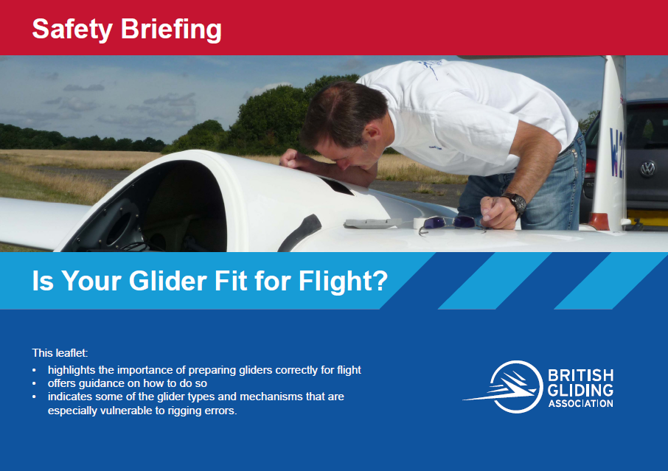
Is Your Glider Fit For Flight

Slide 52
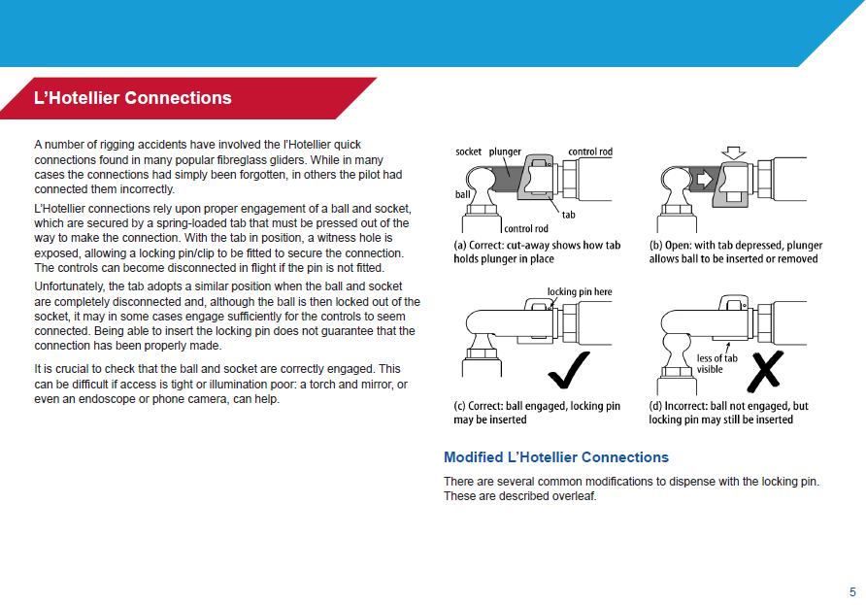

Slide 53
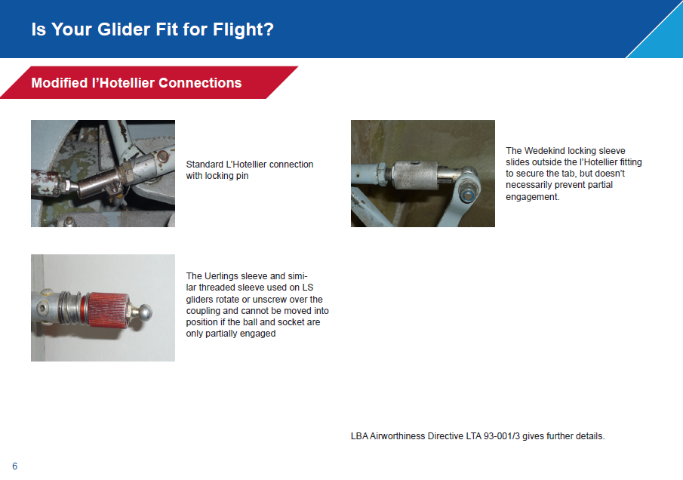

Slide 54
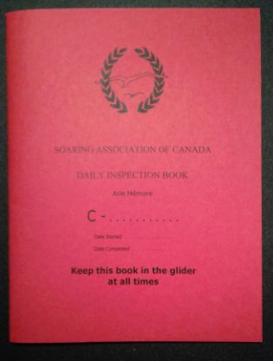
Miss-assembly Prevention
Use a good checklist from AFM or SAC DI book
Interruptions avoided- start over or go back at least two steps
DI by person familiar with type
Positive Control Checks
Critical Assembly Check (by second person)
Pre-flight cockpit checks
Red Hat Policy – Don’t interrupt pilot wearing
See also SSA SSF video “glider miss assembly
http://www.soaringsafety.org/learning/FSvideos.html#toohighonfinal

Slide 55
Heuristics – Why we take risks
Familiarity – The more often we do something the more it becomes a comfortable action despite there being new information on a hazard or risk. E.G. if training for rope break at 300’ you always make a 180 you will likely do so despite head wind and 5000’ runway remaining. 99.9% safe means 1 fatal if risk becomes acceptable standard in 1000 flights. Poor circuits and landings – ground loops etc.
Consistency – once a decision is made it is easier to stay with that decision despite new information, EG pushing a final glide, or weather, or low thermalling.
Acceptance – doing something to get accepted by others (particularly younger men with women) despite the hazard/risk. E.G. competitive, aggressive or risk taking, such as aerobatics or low flying with passenger.
Expert halo – following a leader of a group decisions because of their assertiveness or perceived expertise. It may not be a good decision. E.G. Glider leaves a thermal too low but the others follow because he must know something they don’t.
Social facilitation – group decisions are enhanced risk with more skills of the group despite factors to the contrary. E. G. a group of contest pilots may decide to push weather when individually the might not make that choice.
Scarcity – tendency to value opportunities in proportion to the chance that they may be lost. E.G. Pilot flying a MG may be more willing to take risks over hazardous terrain rather than lose the value of having spent so much money for the capability of a motorized glider.

Slide 56
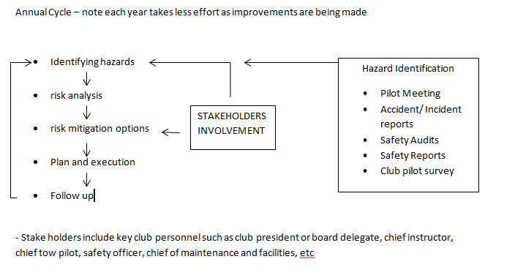
Safety Systems Approach Mitigating club hazards that could lead to emergencies
Hand out white index cards to participants and have them jot down a hazard they perceive at their club. Collect them and then white board the results and discuss how they would go through this process.
Was this process of analysis too hard???

Slide 57
SAFETY SYSTEMS
People will act impulsively with respect to safety before a reasoned approach. Our tendency is to review accidents/incidents from reasoned approach and not the emotional one in which many were created. Mitigation should take this into account.
Safety measures need to address overall safety system and not assume safety is only a linear chain of events and one barrier will work. We need multiple barriers and layers of safety measures.
Operational safety at user end is more relevant in safety matters than a top down safety approach. Must pay attention to pilot concerns, including recognition and acknowledgement of pilot input.
Incident reporting must also be acknowledged and acted upon to encourage reporting. Incident reporters must feel and see that their reports result in a difference to safety.
Focus not as much on what went wrong, but that human error is a symptom of something wrong deeper in the system. Find out how pilots actions made sense at the time given the circumstances.

Slide 58
Summary
Most emergencies can mitigated by flight planning and preparations including careful inspections
Having a plan before take off for take off emergencies
Staying calm, managing stress, and using pilot decision making tools for inflight emergencies
Respecting airspace requirements for visibility and cloud separation, use anti-collision device, maintain a proper lookout, and apply good airmanship.

Slide 59
Simulator Exercises
All Flight exercises possible and low spins
Late/low rope breaks
Drift illusions (peripheral visuals required!)
Tow plane upset recovery
Unusual attitude training slow roll (recovery from inverted), loop, snap roll, barrel roll
Final turns spin recovery scenarios
Flying in turbulence
Ridge soaring and gaggle flying
FLARM drills
Egress ground parachute training

Slide 60
Instructor Notes
To assist discussions and flight training sessions with pilots. Not necessarily part of the presentation. Do not add multiple emergencies together at the same time. Once, one exercise is completed, another can be started on the same flight provide the pilot is not overwhelmed and was briefed. Have pilot practice stress reduction exercise during the exercise. IE breathe, etc!

Slide 61
Instructor Discussion Notes Scenario 1
Pilot factor – after discussion most pilots agree lowest risk is to release and land ahead on available runway (logical brain); but most pilots despite the number of fatalities/crashes will elect to save the canopy or save embarrassment of a poor pre-flight check and accept higher risk of completing a circuit to land (emotional brain wins out most of the time!)
Options identified may include:
Release and land on remaining runway/field!
Hold canopy until high enough to release then side slip in to land if side opening canopy!
Hold on and try to fix canopy closed at higher altitude letting controls go!
Hold on and attempt a no air brake approach/landing!

Slide 62
Instructor Discussion Notes Scenario 2
Pilot factors – pilot ignoring fact that 60 degree bank turn at 2 g stall speed is above min sink speed, pilot rushed and under high stress load has been making series of poor decisions.
Aircraft – ASW -27 high performance glider with airfoil that will likely not give much stall warning at 2g, ASW 27 manual states use of max deflection of controls at low airspeed could cause stall/spin or spiral,
Environment – turbulence and shears possible contribute to stall/spin. Height above ground inadequate for recoveries
External Factor – pilot has committed to not landing out and will accept higher risk to achieve goal
3 x Options include continue plan to thermal and stall/spin, or reduce angle of bank and attempt to center lift, or level out and land in available terrain while still in control

Slide 63
Drift Illusion & Overshoot Protection instructor notes
Instructor demonstrates t o pilot who looks down lower wing, then note that yaw string is straight
Top view
Wind 10-15 kts
side view
Low key point 600’
Start overshoot prevention exercise here @ 300’ agl open air brake accelerate to 70 kts
8°
Common error is pilot wants to raise nose too soon or lower speed because of ground rush. Rotation starts normal at 20’ agl but at 70 kts so descent is checked
If exercise started too soon on final and undershoot likely, return to normal 8° speed &½ brake

Slide 64
Slack rope recoveries -instructor notes
Demonstration of rotor type turbulence and slack rope recovery. Position the glider to one side of the tow plane much higher than normal and accelerate to create a tow rope loop large enough to form an “L”. The pilot then yaws away from the rope to create drag. As the rope starts to straighten out the yaw is reduced to produce less drag to the point that the slack is gone and the nose of the glider is pointed at the tow plane. Yawing towards the tow plane is very dangerous as the loop could wrap around the glider wing.
Pilot mistake when yawing away is to let secondary effect of rudder lower the outside wing which causes an outside slip and moves the glider further to the outside.
If having difficulty creating an adequate loop for the exercise initiate to the inside of the tug in a turn. Request tug make a 45° Turn.

Slide 65
Slack rope recovery – Instructor notes 2
To establish a “too high on tow position” for recovery climb slowly not to lose sight of tow plane or create an upset. The correct position is with wing tips visible from either side of the nose of the glider then initiate a foreword slip with sufficient bank to descend back to the correct position relatively quickly. In turbulence, getting high can occur quickly, so to prevent tow plane upset or unintended release, the effort to get back in position must be done quickly. Pilots tend to execute the recovery slowly, at the same speed as setting up the high position (which was done slowly to prevent an unintended upset) and do not bank and yaw enough to create an effective foreword slip to descend quickly.
Once tow plane wheels are on horizon, they should recover to normal tow. If during a tow in turbulence both lateral and vertical position is compromised correct the vertical first then lateral.

Slide 66
Spin Training instructor notes
Should demonstrate at a safe altitude, entry of spins possible with nose below horizon and airspeed above 1 g stall speed:
Entry from simulated rope break where pilot has not reacted fast enough to lower nose to regain approach speed. Let speed decay to 40 kts and then recover by lowering nose to recovery attitude and aggressively enter a 60° 2 g turn back. (bring elevator back against the stop) recover spin with minimum height loss.
Entry from pear turn after simulating overshooting of final turn at 45 kts. Aggressively enter a 60° 2 g turn towards final. (bring elevator back against the stop) recover spin with minimum height loss.
Should demonstrate thermalling spin entries:
Inside spin from trying to lift inside wing with aileron on wing drop at the stall
Outside spin from trying to lift inside wing with aileron and secondary effect of rudder just before the stall

Slide 67
Shallow slips instructor notes
Practice shallow slips during aero tow 1000’ + initially. Have pilot move glider laterally left and right about 7 meters. Bank angle should be about 10-15 degrees so that low wing tip is on horizon (parallel to ground)and other wing tip is above horizon.
Lowering of the wing and opposite rudder to prevent yaw should be applied at same time.
Once safe control demonstrated by pilot at altitude they can attempt same exercise after lift off (not out more than tug’s wing tip about 5 m) to demonstrate they can get back into correct tow position if moved out of alignment by wind or miss-alignment behind tug.
This exercise can also be done on landing. Line up with side of runway vs centerline and after landing rotation, close airbrakes so wheel does not touch runway surface and sideslip to wards runway centerline keeping nose pointed down runway. Low wing no lower than horizon. Once slip stopped by leveling wing/centering rudder. Re-open ½ airbrake and land normally. Obstacles can be avoided this way on landing.

Slide 68
Shallow slip common errors
When glider swings to the out to one side on take off behind tug, the pilot may attempt to yaw back towards the tow plane not being comfortable to lower the inside wing. This just skids glider and does not correct situation and can make it worse. Point out the amount of bank required in most cases is to lower the inside wing tip to the horizon and keep the nose pointed parallel to the runway center line until behind the tug and this will slip the glider back into position.
Similarly on landing pilots may attempt to change position laterally by adjusting the crab angle with rudder, but this just creates a skid and the glider does not change position. The nose points where they want to go and the pilot may feel better, but unless the glider is banked first to establish the crab angle it is a non effective maneuver.

Slide 69
Wind shears landing - Instructor notes
Key is to prevent loss of control with adequate airspeed
V approach = 1.5Vs + ½ Vw + Vgust
Landing Shears at height sufficient to recover and shears close to ground
On approach, close air brakes, lower nose to recover airspeed, and return to stabilized approach – (airspeed, rate of descent, approach angle are constant to reach reference point)
Close to ground after rotation or just before, the shear causes the glider to drop, close the air brake and adopt the landing attitude. Should the glider drop to the ground the impact energy will be on the main wheel and suspension and not the tail or nose of the glider. Re-open the airbrakes after mainwheel touches to prevent a bounce. If bounce occurs, and airspeed low, close airbrakes and lower nose as it will likely have pitched up. This may be to the level attitude, or slightly nose down if the pitch up is more than a meter. In the first case as the glider starts to settle, go to the landing attitude and gradually open airbrakes to touch down. In the latter case depending on height, lower nose to stay above the stall speed and if speed is sufficient open the air brakes slightly to make the glider less pitchy (PIO) as the glider settles adopt the landing attitude again and slowly increase the air brakes as you get closer to the ground.

Slide 70
Covered ASI or Altimeter Instructor notes
Cover the ASI with an instrument cover or “post it”, at altitude
Start at best L/D or bug speed. Have pilot not three things at each airspeed selected: Attitude to horizon, sound of air over aircraft, and feel of controls.
Lower nose to 60 kts and note differences, slow to 45 kts note differences, then ask pilot to speed up to bug speed again and let you know when the feel they have the target speed, give them the actual readout from your ASI. Repeat for 60 and 45 again. Ask them if they would be confident to fly the circuit without ASI. If yes, set that up as another exercise when possible. Do not combine this with other emergencies as they may be overwhelmed.
Cover Altimeter similarly and fly the circuit without it. Instructor monitor from their ASI for safety.

Slide 71
Slack Rope Recoveries
Covered in Instructor manual
SSF video https://www.youtube.com/watch?v=3Z1YCKUguR8

Slide 72
Off field landing – instructor notes
Ideally this would be a grass strip they have never landed at before and shorter than what the pilot is used too near the club field so aero tow out is possible , safe and effective.
If not possible then this can be simulated at home field.
Discuss decision heights in the air and field selection criteria (SSSLOW) and let them select a suitable field.
Instructor then selects training field and reads the pilot onto it. This is important, they must identify the same field you select because it will not work for safety if they are setting up to land somewhere different!
Have them plan backwards and identify where they would like to be at each phase but adapt the plan as they execute it to obtain a safe outcome.

Slide 73
Tow emergency signals – instructor notes
You may want to review the signals during tows when time permits. Tug waggles rudder while correcting with ailerons to prevent roll. Indication is that tow pilot has observed something wrong with glider likely air brakes open. Glider pilot checks air brakes closed and locked. If closed check wings etc. An airbrake may have dropped open below wing, or another rope caught on tow rope, etc.
Tow plane rolls wings to indicate release (usually a tow plane emergency but some clubs use signal for any release reason such as at RP). Glider pilot must release immediately (tow plane will release their end next and glider will have to deal with rope hanging from nose or tow ring going through canopy).
Glider cannot release – glider moves out to the side of tow plane where tow pilot can see glider (left side) and rocks wings then moves back behind tow plane and then moves to the low tow position. Common problems is that glider pilot does not maintain sufficient left rudder to prevent nose yawing towards to plane. Wings are rocked with aileron only, while holding left rudder input in.
Descent on tow can be practiced if desired. Some air brake will be required and moving up a bit into prop wash may be required to increase drag. Descent at about 300 fpm is sufficient. The relatively remote possibility that a landing would have to be executed and higher risk an actual landing while attached to the tug is not recommended.

Slide 74
Off field landing – instructor notes
Plan backwards but fly forwards adapting as conditions dictate
Selected Farm field
Low
Key Pt
Ref pt
Club runway
Planned
Circuit
Instructor confirms with pilot they will or will not make field then takes control and lines up on club airfield. Pilot may land if not disoriented.

