Slide 1
Lookout and Collision Avoidance
Joerg Stieber
Graphs from Aerokurier

Slide 2
The Eye – Field of Vision
210 degrees – Center 60 degrees
Center
  Area covered by both eyes, sharp focus, colors, but no night vision
  1 sqmm of retina is mapped to 10,000 sqmm of brain surface
Periphery
  Fuzzy, weak colors (brain compensates) , night vision, better movement recognition movement in the periphery triggers eye reflex
  Outer periphery only covered by one eye
Notes:
Simulate 210 degrees with arms

Slide 3
The Eye – Field of Vision
Stereoscopic Vision (depth perception)
  Only effective under 100m
  For airspace observation not relevant
  To gage distance the pilot relies on apparent size of the object. This can lead to surprises if the object is different in size than expected, i.e.
    Kids’ balloon vs. hot air balloon
    Model airplane vs. real plane
    Model airfield vs. real airfield

Slide 4
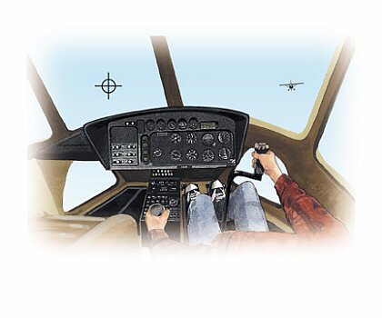
The Eye – Blind Spot
We all have a blind spot in each eye
One eye compensates for the other eye’s blind spot
The brain cheats a bit and fills in the background
Cover your left eye, focus on the crosshairs and move the sheet closer to your eyes.
Notes:
Demo several eye teasers.

Slide 5
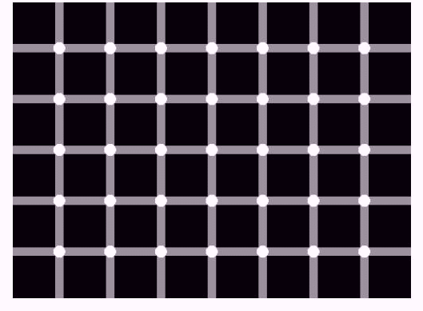
Count the Black Dots!

Slide 6
The Brain
Filters
Recognizes shapes
Controls eye movement and reflexes
Compensates for color weakness in the periphery
Fills in the blind spot.

Slide 7
The Brain
Since the brain plays such a prominent role,
Seeing can be learned!
How to look and where to look

Slide 8
Collision Course
If you are flying straight and level and are on a collision course with another aircraft also flying straight and level:
The target will appear to have no relative movement
It will just slowly grow at first, then explode
Since there is no relative movement, it will be difficult for your motion sensitive peripheral vision to pick it up (peripheral eye reflex will not be triggered)
A clean canopy and frequent eye movements (scanning) are important. Don’t give a collision risk the chance to hide among specks on the canopy!

Slide 9
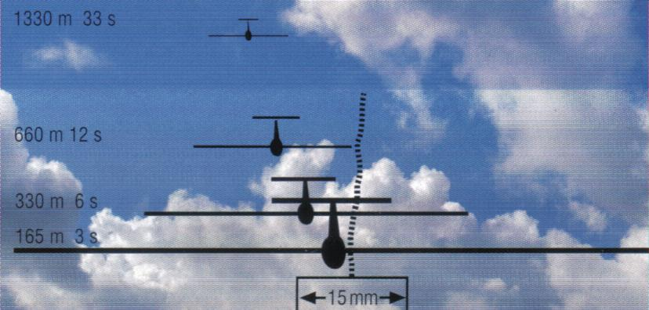
Conflict Situations and Reaction Time
Head-on
Notes:
Both gliders do 55kts
Point out yaw string

Slide 10
Conflict Situations and Reaction Time
Head-on
Closing speeds are very high
Modern gliders are difficult to see head-on
Be particularly alert around turnpoints!
Notes:
Both gliders do 55kts
Point out yaw string

Slide 11
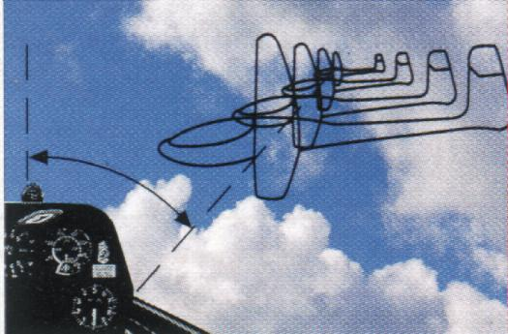
Conflict Situations and Reaction Time
Converging
Outside the center of vision!
Going into turnpoints!
Finishes!
Notes:
Both gliders do 55kts
Point out yaw string

Slide 12
Convergence Angles and Closing Speeds
60 degree convergence is the most dangerous:
In your peripheral vision
No relative movement
Yet still high closing speed

Slide 13
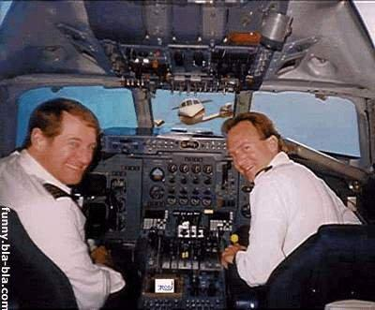
How Can We Prepare Ourselves?
Keep your head out of the cockpit at all times!!

Slide 14
How Can We Prepare Ourselves?
Practice Scanning
  Use the horizon as anchor to sweep back and forth in a 120 degree arc (60 deg to each side). This is the zone with the highest probability of conflict
  Do not focus on singular points on the horizon (trees, towers, hills)
  Aircraft below the horizon are much harder to spot than above
  Be alert if you spot an object with no relative movement. Do not take your eyes of it until you are satisfied there is no danger of a collision!
Try to train and use your peripheral vision

Slide 15
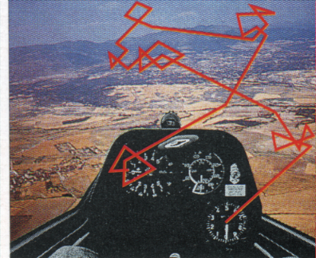
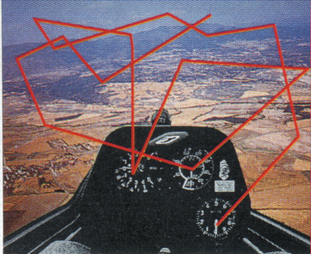
Scanning Techniques
Novice
Experienced Pilot
Notes:
Explain scans

Slide 16
Shape Recognition
One of the brain’s functions is to filter the dazzling stream of information provided by the eyes
From childhood on, you have been trained to recognize the shapes of letters and words. As a consequence, you can read a word within a split second.
We have to teach our brains to pick out and recognize airplanes and their direction of flight just as quickly

Slide 17
Shape Recognition
س
SOARING
What shapes and words did you recognize?

Slide 18
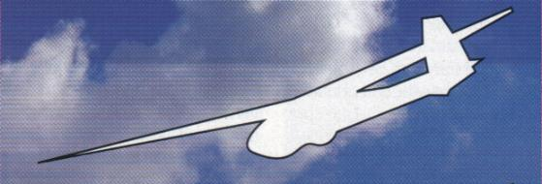
Shape Recognition
Is the glider flying away from you?

Slide 19
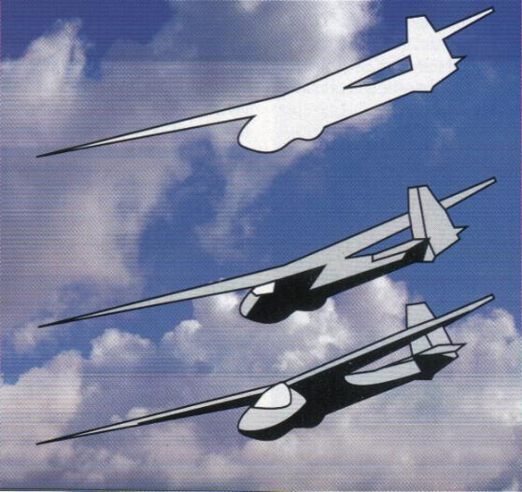
Shape Recognition
CAUTION!
Your first assumption
might be wrong!

Slide 20
Anticipation
It is much easier to spot targets if you know where to look
Anticipate whether or not a conflict situation could develop
  You spot a tow taking off – where will it be in 2 minutes?
  A glider just released – what route will the tow plane take from there?
  You are heading for a gaggle of circling gliders – which ones are more likely to be a problem? Above or below the horizon?
  You are in a thermal and see other gliders heading for you – what is going to happen next?

Slide 21
Other Factors
Head Gear
  It is important to wear a hat that does not obscure your field of vision. Wearing a ball cap is like painting the top third of the canopy black
Sunglasses
  Our eyes cannot focus in the UV spectrum. When selecting sunglasses, make sure you get good UV filter characteristics. On a bright day distant objects appear much clearer when the UV portion of the light is filtered out.
  The same effect makes thermals visible on hazy days
  Serengeti and Ray Ban work well

Slide 22
Other Factors - Focus
Avoid being distracted by gadgetry in your glider
PDAs, GPS, Data Loggers are wonderful devices but they focus your attention on the wrong things
Your life depends on keeping your eyes and mind on what’s happening outside the cockpit!

Slide 23
Other Factors – Brain Fitness
Since the brain is so central to vision and recognition, you should make sure it is running in high gear. The following factors degrade brain performance:
Lack of oxygen (hypoxia)
Dehydration – make sure you drink enough before and during your flight
Alcohol, drugs – hangovers, allergy meds
Lack of sleep

Slide 24
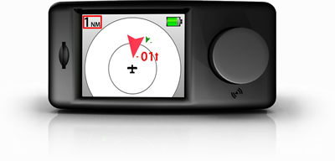
New Developments
Power FLARM
GPS based collision warning system
In production since 2004 – over 10,000 installations in Europe
Affordable ~ $1,600 with integrated logger function
Low power consumption
The best anti-collision system available
but only beneficial if widely used

Slide 25
Fly Safely!
Although there is no absolute protection against mid-air collisions, practicing good lookout techniques, knowing how to look and where to look and recognizing potentially dangerous situations will help us to reduce the risk.
Soaring is a visual experience. Being at a high level of alertness not only increases the intensity of the experience it also makes it a safer one.

